Slide 1
Internet of Things in Agricultural Education, the Gödöllő example
Ferenc Magyar chancellor
Tibor Mezei adviser Szent István University

Slide 2
What I’m going to say?
What are the challenges of the Industry 4.0 and the Farming 4.0 for agricultural higher education?
What are the challenges for universities to teach the Z generation?
What does digitization mean in higher education?
Can non-smart universities be able to train professionals for the smart world?
What does the Internet of Things mean in higher education?
What the Szent István University has done so far and what experience it has?

Slide 3
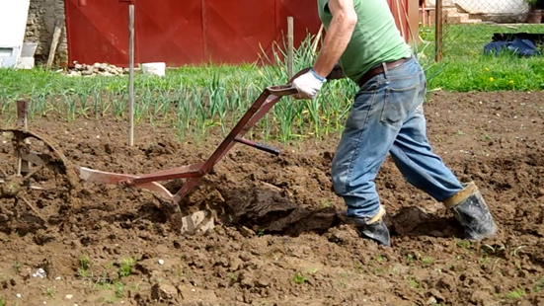
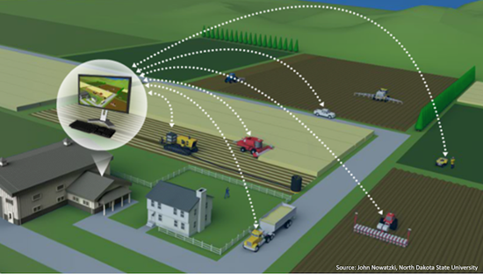
The major challenges Agricultural and food production
Traditional farming and precision farming in agriculture at the same time (Farming 3.0)
Robotic agricultural production based on digital network integration has begun (Farming 4.0)
The use of artificial intelligence is under experimental stage (Farming 5.0)
The amount of new knowledge exponentially increases The teaching and learning time at universities is not increasing
Knowledge and training methods need to be renewed at universities

Slide 4
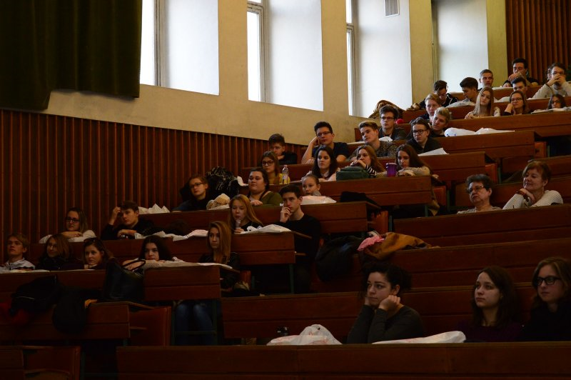
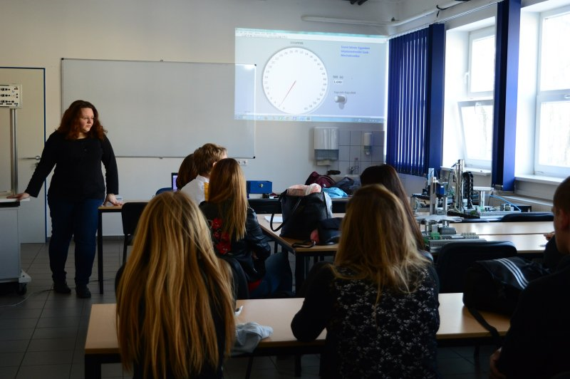
Traditional university
Traditional university training is slowly responding to changes
If we change the curriculum, the result will be displayed in 3-5 years
Nowadays, over a period of 5 years, some of the knowledge is obsolete
This contradiction must be resolved. But how?
Why do we talk about a gap between social or agricultural needs and university education?
More effective university operation is needed

Slide 5
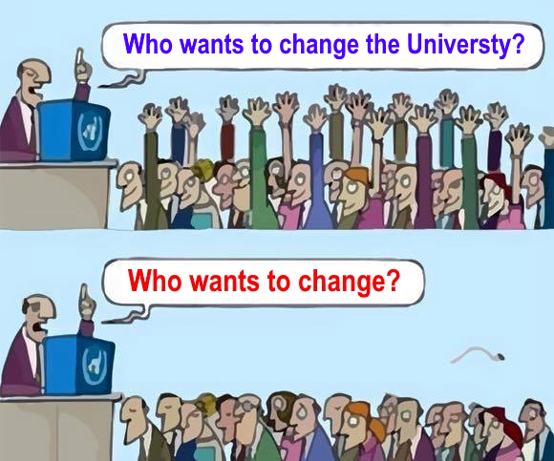
Adapting to new digital technologies

Slide 6
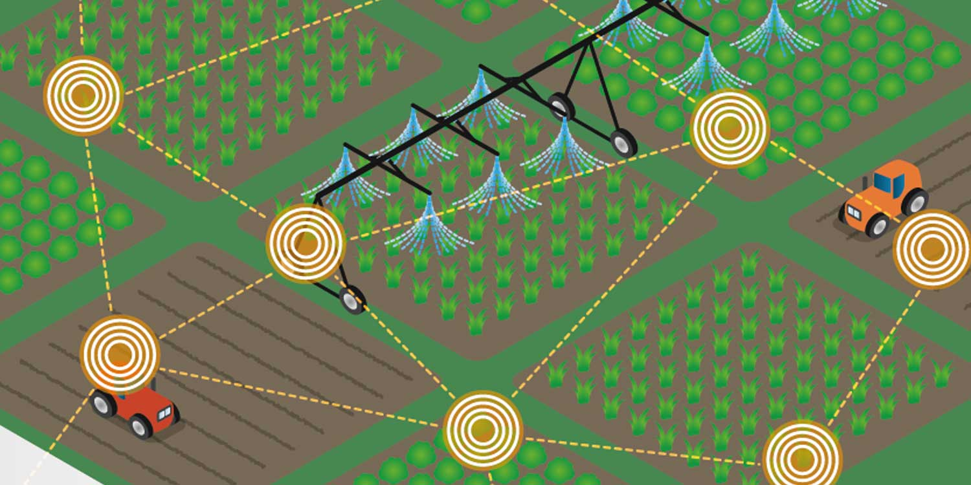
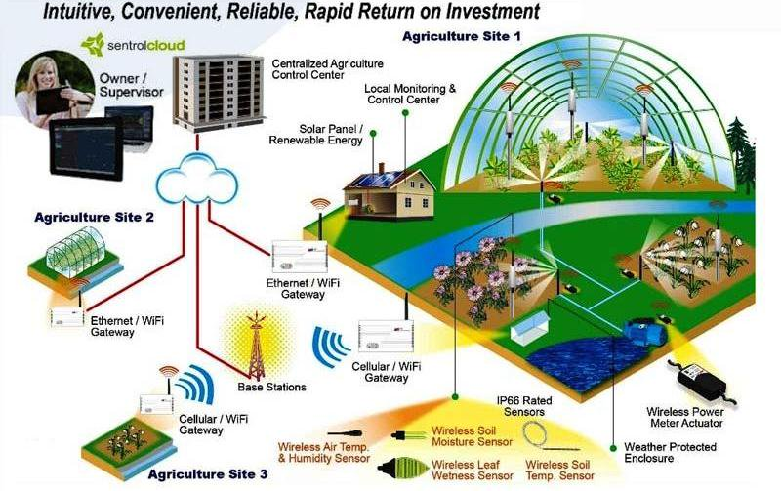
Lack of specialist in higher education and agriculture
Lack of good agricultural IT professionals
Hay Group (International Survey Industry 4.0)
By 2011, the main problem was the lack of engineers
After 2011 the main problem was the lack of relevant knowledge engineers
96% of chief academic officers and 44% of students believe new graduates have the requisite digital skills for the workforce,
only 11% of business leaders agree

Slide 7
Z generation, „digital natives”
Not the teacher is the main source of knowledge
At the moment of questioning, they are looking for an immediate response on the Internet
They are questioning each other in the forums
They are not just looking for information but sharing content
They create a huge information network (forums, chat rooms ...)
The Internet is the media of learning and its platform is the center of personal learning
The skills, competencies and abilities of the new generations have changed
The training methods need to be changed

Slide 8
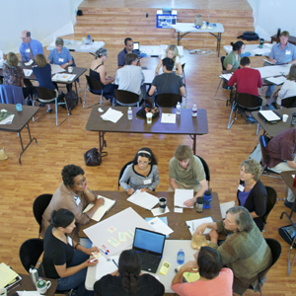
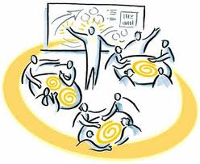
New problems - new approaches
Z generation don’t prefer the trainings, based on lectures
They prefer problem-based education, collaborative learning and project works
This requires
new types of teachers with new skills;
a moderating facilitator teacher role for group activities;
a teacher who has high level of technological knowledge and ability

Slide 9
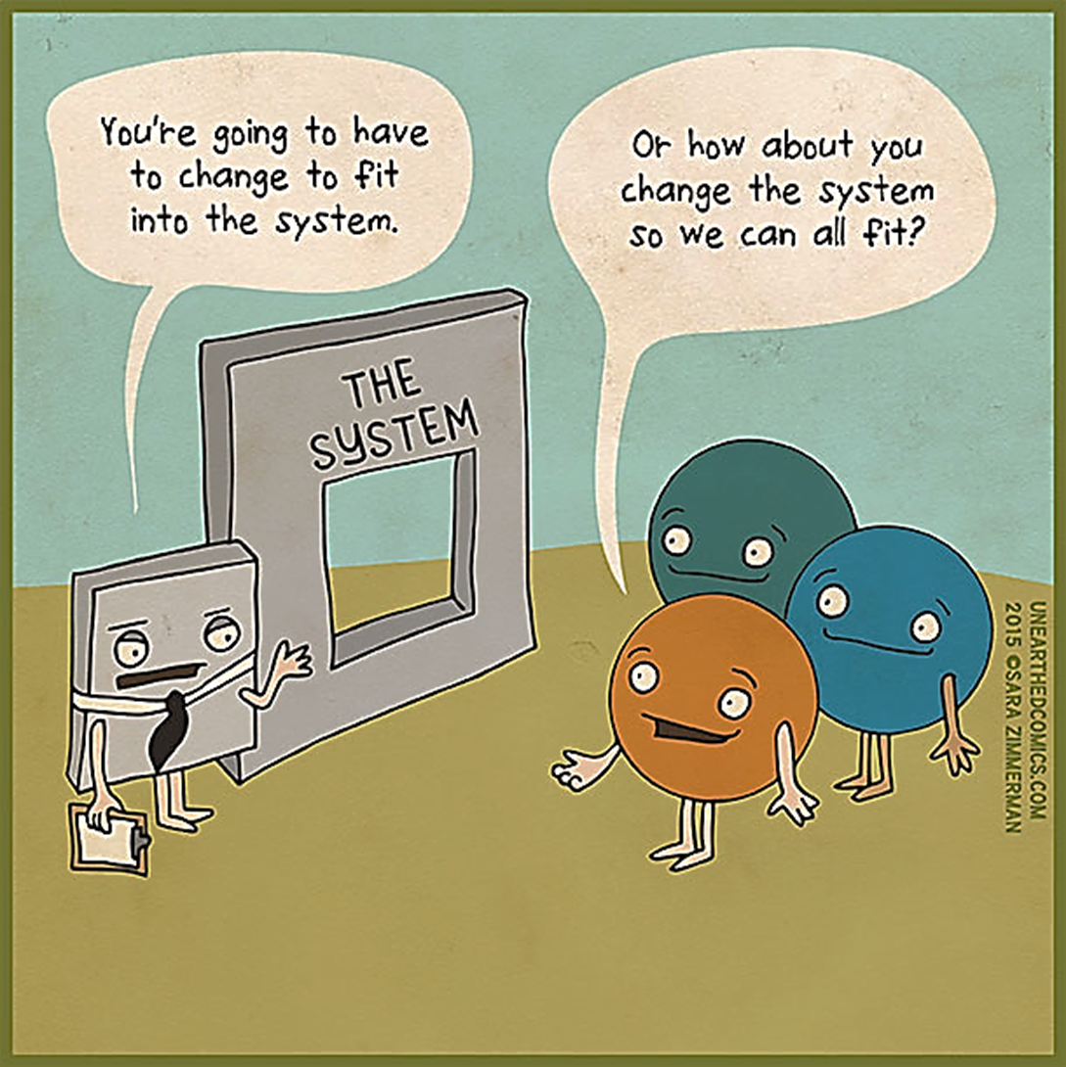
What will be the solution?

Slide 10
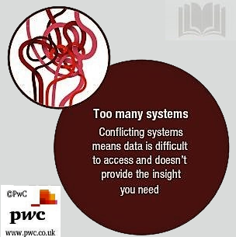
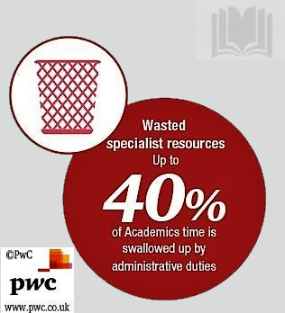
Difficulties
A

Slide 11
Difficulties
A

Slide 12
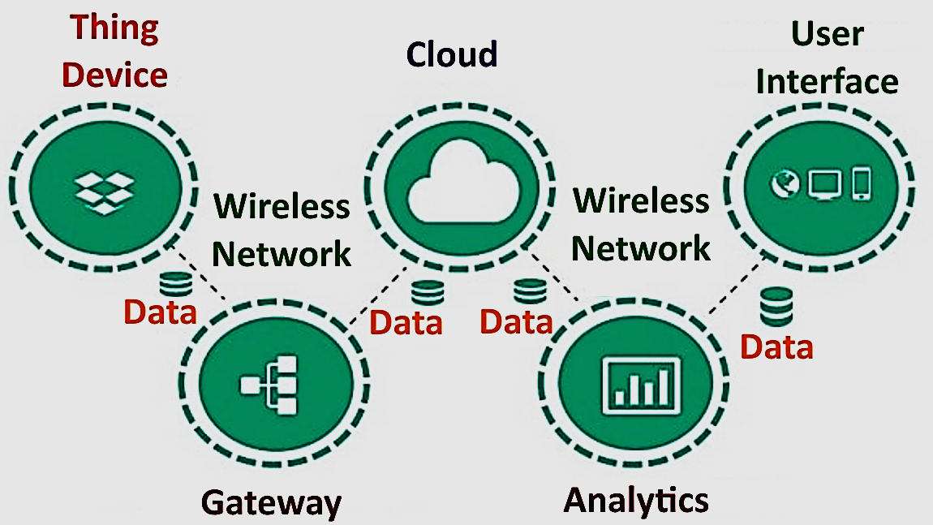
Major components of Internet of Things (IoT)
Every smart or intelligent thing, object, device, machine connects to the Internet

Slide 13
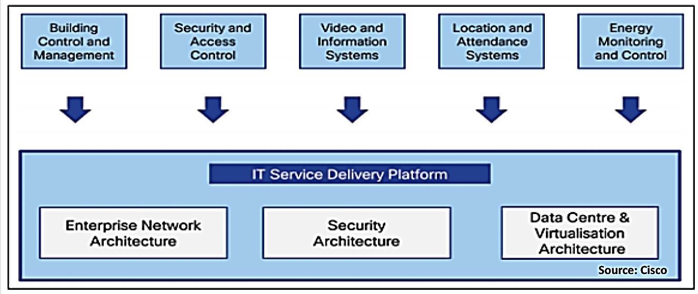
Digital Campus System; IoT
This is a platform for students, professors, staff and campus administration, to get digitally all kinds of information

Slide 14
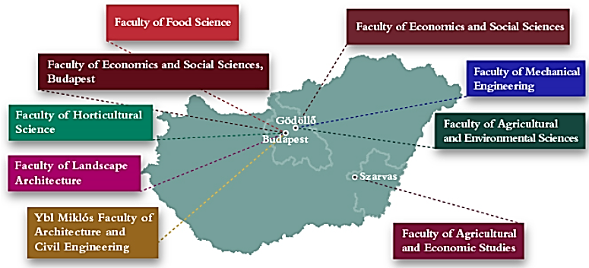
Szent István University
Multicampus Integrated Knowledge Management System
BUDAPEST
Ybl Miklós Építéstudományi Kar
BEREGSZÁSZ
KOMÁROM
SZARVAS
Agrár- és Gazdaságtudományi Kar
MAROSVÁSÁRHELY
CSÍKSZEREDA
ZENTA

Slide 15
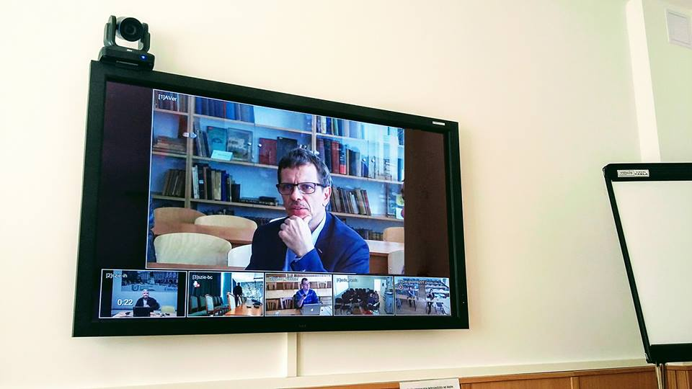
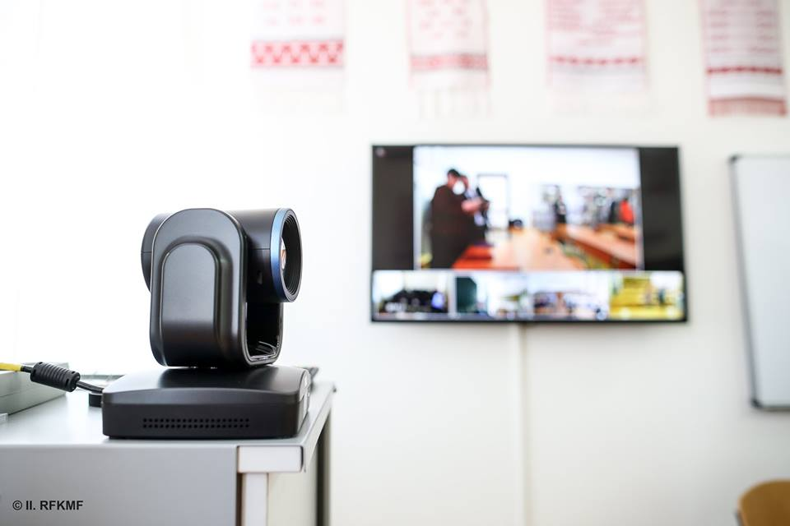
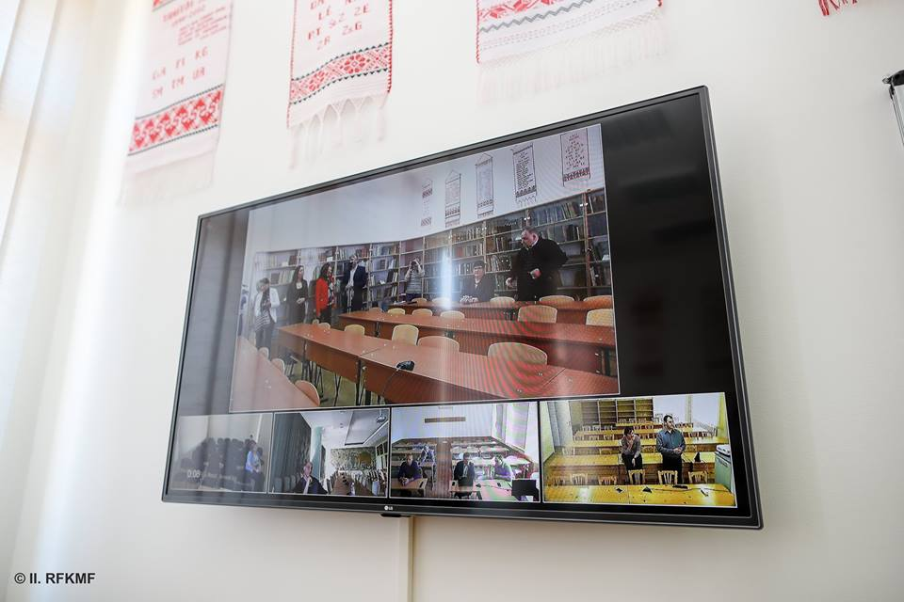
Multiple campus video conferencing system
Modern teaching technology, while retaining personal presence
We are simultaneously interconnecting four foreign and Gödöllő and Budapest training sites
Save money, time and energy (eg: Miercurea Ciuc is 700 km away from Gödöllő)
Further development opportunities
Fields of application: higher education, adult education, professional consultations

Slide 16
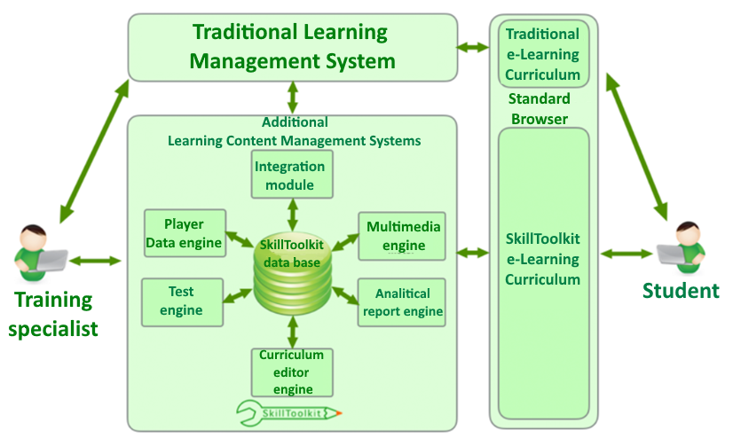
The university of tomorrow
A
–––––––––––––––––––––––––––––––––––––––––––––––––––––––––––––––––––––––––––––––––––––––––––––––––––––––––––––––––––––

Slide 17
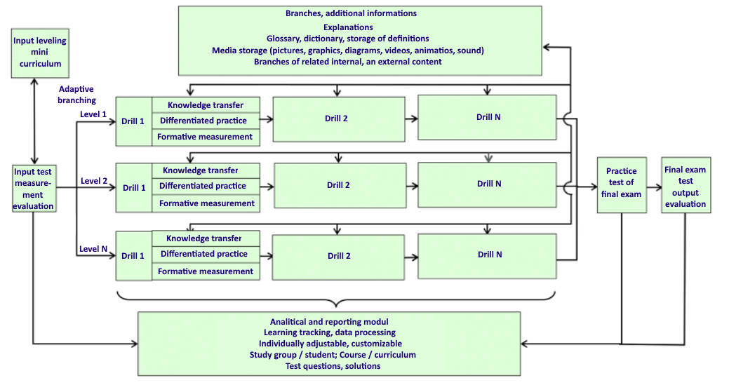
Structure of „Internet of Learning Materials”
A
–––––––––––––––––––––––––––––––––––––––––––––––––––––––––––––––––––––––––––––––––––––––––––––––––––––––––––––––––––––

Slide 18
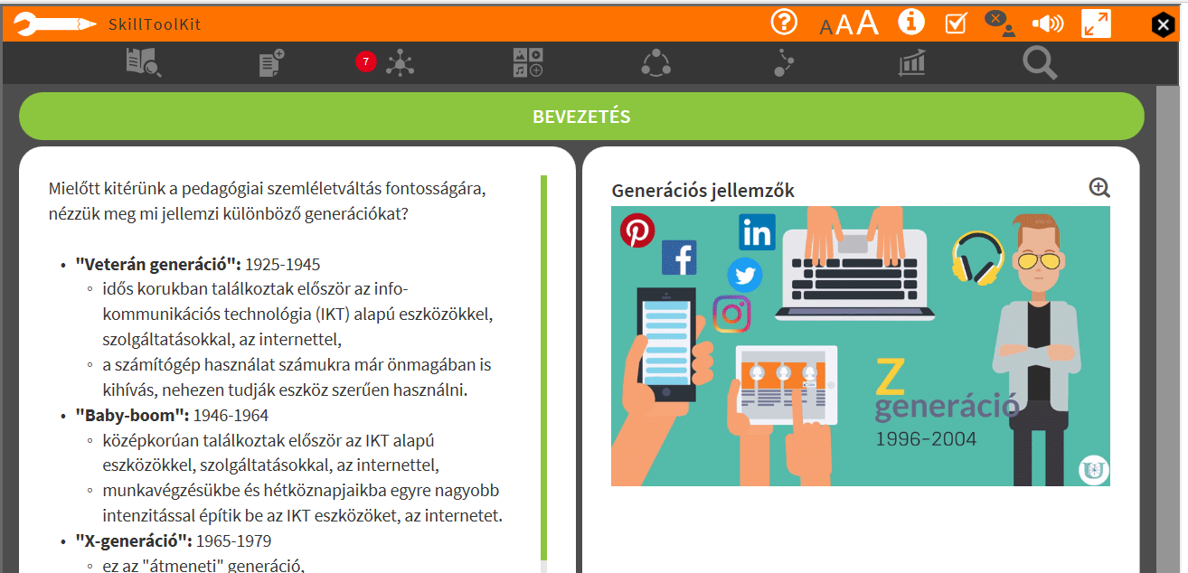
SkillToolkit screen page
A

Slide 19
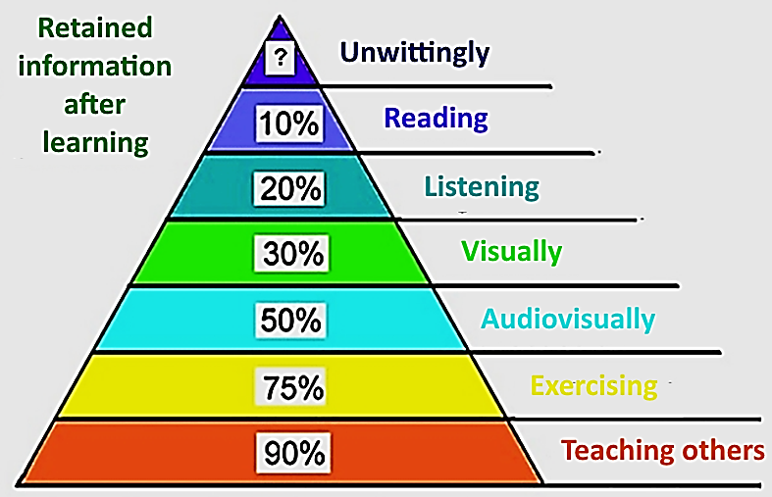
Effectiveness of learning methods
A
–––––––––––––––––––––––––––––––––––––––––––––––––––––––––––––––––––––––––––––––––––––––––––––––––––––––––––––––––––––

Slide 21
Thank you for your attention!
––––––––––––––––––––––––––––––––––––––––––––––––––––––––––––––––––––––––––––––––––––––––––––––––––––––––––––––––––––

