Slide 1
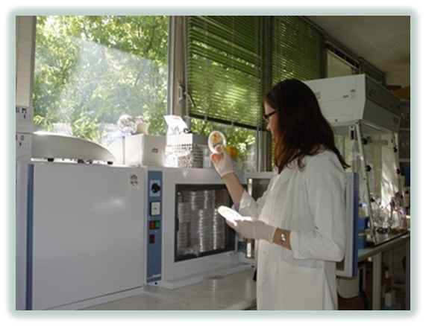
The role of the Szent István University's Doctoral Schools in today's scientific life
All schools have been accredited by the National Accreditation Committee in 2005 and 2013

Slide 2
Introduction
In 1993 fifteen Ph.D programs have been founded at the University they were then re-organized and re-accredited as Doctoral (Ph.D) School in 2002.
Degrees are awarded in nine scientific areas including
Animal husbandry
Biological Sciences
Environmental Sciences
Plant – and Horticultural Sciences
Food Sciences
Landscape Architecture and Landscape Ecology
Management and Business Studies
Regional Sciences
Agricultural Engineering
Notes:
PhD Schools:
-Animal Sciencesees are aworded
-Biological Sciences
-Crop Sciences
-Engineering
-Environmental Sciences
-Management and Business Studies
-Veterinary Sciences

Slide 3
Doctoral Schools of SZIU
Doctoral School of Animal Husbandry
Doctoral School of Biological Sciences
Doctoral School of Environmental Sciences
Doctoral School of Crop Science
Doctoral School of Food Sciences
Doctoral School of Horticultural Sciences
Doctoral School of Landscape Architecture and Landscape Ecology
Doctoral School of Management and Business Administration
Enyedi György Doctoral School of Regional Sciences
Doctoral School of Mechanical Engineering
Faculty of Agricultural and Environmental Sciences
Faculty of Food Sciences
Faculty of Horticulture Science
Faculty of Landscape Architecture and Urbanism
Faculty of Economics and Social Sciences
Faculty of Mechanical Engineering
Notes:
PhD Schools:
-Animal Sciences
-Biological Sciences
-Crop Sciences
-Engineering
-Environmental Sciences
-Management and Business Studies
-Veterinary Sciences

Slide 4
Szent István University
Animal Husbandry Doctoral School
The most important research objectives are:
Role of modern animal biotechnology and genomic methods in animal breeding and gene conservation
Development of genome editing techniques and genetic modifications for establishment of animal models of different human diseases
Mode of action of several important mycotoxins in particular
Oxidative stress-inducing effect and its regulation
Wildlife ecology and conservation with special focus on ungulates, large carnivores, and sustainable management
Fish breeding, reproduction, genetics, physiology, biotechnology and water toxicology
Notes:
PhD Schools:
-Animal Sciences
-Biological Sciences
-Crop Sciences
-Engineering
-Environmental Sciences
-Management and Business Studies
-Veterinary Sciences

Slide 5
Szent István University
Animal Husbandry Doctoral School
Number of PhD students: 33
Number of international students: 6
Number of academic staff: 83
Notes:
PhD Schools:
-Animal Sciences
-Biological Sciences
-Crop Sciences
-Engineering
-Environmental Sciences
-Management and Business Studies
-Veterinary Sciences

Slide 6
Szent István University
Biological Sciences Doctoral School
Research programs in:
Plant Ecology, Ecophysiology
Zoology, Animal Ecology
Agricultural Biotechnology
Molecular Background of Variability of Microorganisms
Notes:
PhD Schools:
-Animal Sciences
-Biological Sciences
-Crop Sciences
-Engineering
-Environmental Sciences
-Management and Business Studies
-Veterinary Sciences

Slide 7
Szent István University
Biological Sciences Doctoral School
Number of PhD students from the country: 17
Number of PhD students from abroad: 6
Number of academic staff involved: 71
Number of PhD students since 2000: 88
Notes:
PhD Schools:
-Animal Sciences
-Biological Sciences
-Crop Sciences
-Engineering
-Environmental Sciences
-Management and Business Studies
-Veterinary Sciences

Slide 8
Szent István University
Doctoral School of Environmental Sciences
The most important research objectives are:
Local and global environmental issues, including the carbon, the nitrogen and water cycle
The nature, properties, functions and mapping of soils
Climate smart agriculture (land use, nutrient supply, water management, waste management)
Observation and remediation technics in microbiology
Remote sensing and GIS in environmental management
Notes:
PhD Schools:
-Animal Sciences
-Biological Sciences
-Crop Sciences
-Engineering
-Environmental Sciences
-Management and Business Studies
-Veterinary Sciences

Slide 9
Szent István University
Doctoral School of Environmental Sciences
Number of PhD students: 58
Number of graduated PhD students: 47
Number of international students: 12
Number of academic staff: 112
Notes:
PhD Schools:
-Animal Sciences
-Biological Sciences
-Crop Sciences
-Engineering
-Environmental Sciences
-Management and Business Studies
-Veterinary Sciences

Slide 10
Szent István University
Crop Sciences Doctoral School
Research programs in:
Plant molecular genetics and gene technology
Molecular markers and molecular plant breeding
Arthropod assemblages and pests and predators of agro-ecosystems
Fungal diseases of crop plants
Theory and practice of weed management
Agro-ecologycal impacts on yield and quality of field and horticultural crops
Notes:
PhD Schools:
-Animal Sciences
-Biological Sciences
-Crop Sciences
-Engineering
-Environmental Sciences
-Management and Business Studies
-Veterinary Sciences

Slide 11
Szent István University
Crop Sciences Doctoral School
Number of PhD students: 37
Number of international students: 7
Number of graduated PhD students: 62
Number of core members: 14
Number of academic staff: 88
Notes:
PhD Schools:
-Animal Sciences
-Biological Sciences
-Crop Sciences
-Engineering
-Environmental Sciences
-Management and Business Studies
-Veterinary Sciences

Slide 12
Szent István University
Doctoral School of Food Sciences
The most important research objectives are:
Food chemistry and food biochemistry in nutrition chain
Food safety, quality assessment and quality maintenance of foods
Food biotechnology
Process engineering, measurement and control for food technology
Notes:
PhD Schools:
-Animal Sciences
-Biological Sciences
-Crop Sciences
-Engineering
-Environmental Sciences
-Management and Business Studies
-Veterinary Sciences

Slide 13
Szent István University
Doctoral School of Horticultural Science
Scientific areas and topics include:
Horticultural biology
Ornamental plants and dendrology
Medicinal and aromatic plants
Fruit bearing plants
Viticulture
Vegetables and cultivated fungi
Horticultural plant medicine
Notes:
PhD Schools:
-Animal Sciences
-Biological Sciences
-Crop Sciences
-Engineering
-Environmental Sciences
-Management and Business Studies
-Veterinary Sciences

Slide 14
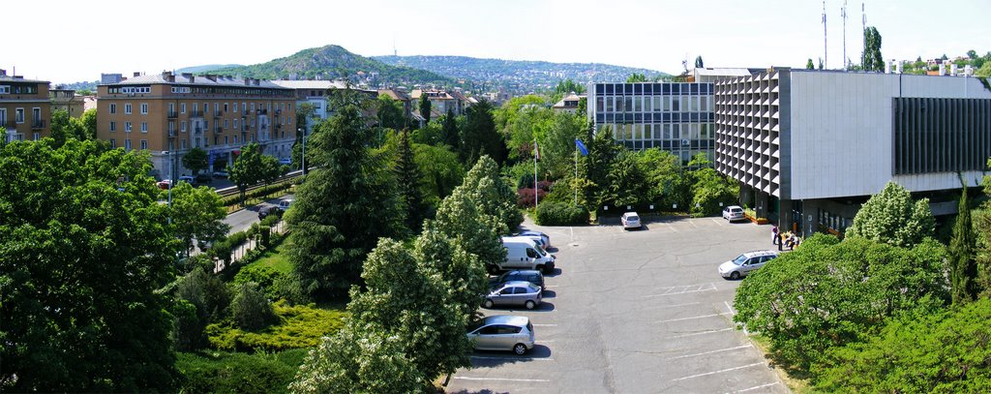
Szent István University
Doctoral School of Horticultural Science
Number of PhD students: 50
Number of international students: 5
Number of Departments: 16
Number of academic staff:
50 supervisor
150 professional instructor
Notes:
PhD Schools:
-Animal Sciences
-Biological Sciences
-Crop Sciences
-Engineering
-Environmental Sciences
-Management and Business Studies
-Veterinary Sciences

Slide 15
Szent István University
Landscape Architecture and Landscape Ecology Doctoral School
The most important research objectives are:
Creative understanding of aesthetics and social sciences with the knowledge of ecological and technical sciences
Environmental impact assessments
Studies in settlement ecology and quality of environment
Principles and methods in landscape protection and rehabilitation
Adaptation to climate change in the field of water management and agriculture
Notes:
PhD Schools:
-Animal Sciences
-Biological Sciences
-Crop Sciences
-Engineering
-Environmental Sciences
-Management and Business Studies
-Veterinary Sciences

Slide 16
Szent István University
Enyedi György Regional Sciences Doctoral School
The most important research objectives are:
Regional environmental protection aspects of sustainable development
The social, economic and environmental challenges of the tourism
Urban planning
Examination of economic factors influencing regional competitiveness in land and space use, elaboration of directions for strategic development
Investigation of adapting methods which support spatial planning and regional development and of their application
Monitoring of settlement network
Study of shopping centers in the largest cities in Central Europe
Notes:
PhD Schools:
-Animal Sciences
-Biological Sciences
-Crop Sciences
-Engineering
-Environmental Sciences
-Management and Business Studies
-Veterinary Sciences

Slide 17
Szent István University
Management and Business Administration
Doctoral School
The most important research objectives are:
Environmental, Agricultural and Food Economics
Business Management and Strategic Enterprise Development
Finance and Accounting
Human Research Management
Management and Leadership
Marketing and Supply Chain Management
Notes:
PhD Schools:
-Animal Sciences
-Biological Sciences
-Crop Sciences
-Engineering
-Environmental Sciences
-Management and Business Studies
-Veterinary Sciences

Slide 18
Szent István University
Mechanical Engineering Doctoral School
The most important research objectives are:
Energetics of Agriculture and Environmental Engineering
Energetics and physics of buildings
Heat and mass transport processes
Energy resources in agriculture and in forestry
Application of solar energy
Modelling of the geothermal energy
Wind energy systems
Combined and hybrid energy systems
High frequency and microwave energy used in food processing
Technical and technological questions of environment protection
Ecological correlation of settlement and development of area
Protection of water-base
Principle of environmental industry
Engineering Economics
Notes:
PhD Schools:
-Animal Sciences
-Biological Sciences
-Crop Sciences
-Engineering
-Environmental Sciences
-Management and Business Studies
-Veterinary Sciences

Slide 19
Szent István University
Mechanical Engineering Doctoral School
Number of PhD students: 37
Number of international students: 7
Number of academic staff: 70
Notes:
PhD Schools:
-Animal Sciences
-Biological Sciences
-Crop Sciences
-Engineering
-Environmental Sciences
-Management and Business Studies
-Veterinary Sciences

Slide 20
summary
Szent István University receives 54 students for state scholarship programs every year
Ph.D degrees are awarded in nine main scientific areas including: agricultural engineering, animal husbandry, biological science, environmental science, plant – and horticultural science, food science, landscape architecture and landscape ecology, management and business studies, and regional science
the PhD courses have changed in our country
Number of PhD students: 370
Number of international students: 85
Number of core members: 91
Number of academic staffs: 803
Number of supervisors: 275
Notes:
PhD Schools:
-Animal Sciences
-Biological Sciences
-Crop Sciences
-Engineering
-Environmental Sciences
-Management and Business Studies
-Veterinary Sciences

Slide 21
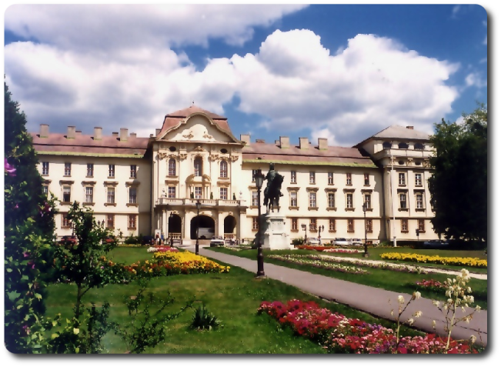
Thank you for your attention!
–––––––––––––––––––––––––––––––––––––––––––––––––––––––––––––––––––––––––––––––––––––––––––––––––––––––––––––––––––––
Szent István University, H-2100 Gödöllő, Páter Károly utca 1. Tel.: +36-28-522-000 E-mail: international@szie.hu
Notes:
Picture of apoteozis?
This picture is of a sculpture found in the Aula of our Faculty of Mechanical Engineering.
It’s creator, the famous Hungarian sculptor Amerigo Toth, was somewhat of a Renaissance Man, like Leonardo Da Vinci.
He was skilled and educated in many different sciences and crafts.
He was a painter, an actor, an auto racer, and sculptor and lived and worked throughout Europe.
He was actually in the second Godfather film as Al Pacino’s bodyguard.
We like to think of him as a model for our university as we also seek success through being good at many differentthings throughout the world

