Slide 1
Microbiological hazards in food production
ASSOC. PROF. ING. MIROSLAVA KAČÁNIOVÁ, PHD.,
Department of Microbiology,
Faculty of Biotechnology and Food Sciences,
Slovak University of Agriculture in Nitra, Slovakia

Slide 2
Important microbial hazards  Bacteria – Salmonella, Campylobacter, Listeria, Clostridium botulinum, Escherichia coli O157:H7;  Virus - Calicivirus (including norovirus), Rotavirus, Hepatitis A virus;  Parasites – Trichinella, Giardia, Sarcocystis, Cryptosporidium;  Zoonosis – BSE, Campylobacteriosis, Salmonellosis, ; Natural toxins – Mycotoxins (aflatoxins, ochratoxin A), Shellfish toxins, Glycoalkaloids, Lectins.

Slide 3
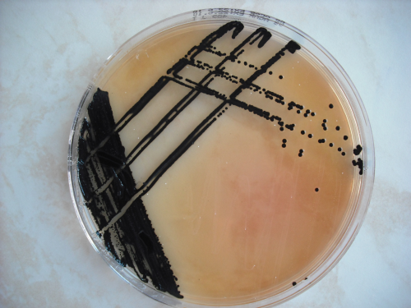
Salmonella
Salmonellosis is the most common food-borne bacterial disease in the world. Salmonella is a significant pathogen for food-producing animals and these animals are the primary source of salmonellosis. It is estimated that herd prevalence varies between 0% and 90%, depending on the animal species and region. The pathogen is spread by trade in animals and non-heated animal food products.

Slide 4
Virulence
Understanding the mechanisms behind the survival of Salmonella bacteria, as they invade an exposed animal, and their ability to cause disease would enable researchers to prevent much of the suffering and economic losses caused by this pathogen. However, despite substantial research efforts, progress has been limited. The current knowledge may be summarised as follows. Following oral uptake, Salmonella is successively exposed to:
a) low pH in the stomach,
b) the strong antimicrobial effect of bile,
c) decreasing of oxygen supply,
d) normal gut flora and metabolites,
e) intestinal peristalsis,
f) cationic antimicrobial peptides present on the surface of epithelial cells.

Slide 5
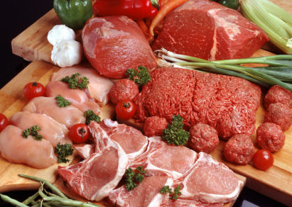
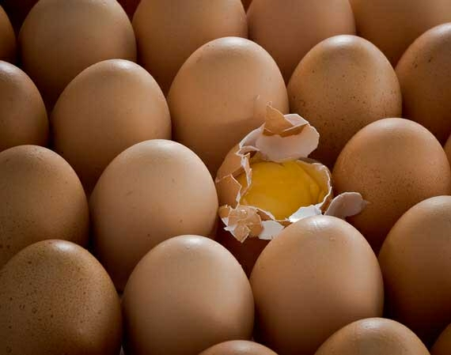
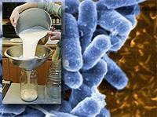
Animal sources of food-borne salmonellosis
An EU scientific committee concluded that the food categories that possibly pose the greatest hazard to public health include:
-raw meat and some meat products intended to bee a ten raw,
-raw or undercooked poultry meat products,
-eggs and products containing raw eggs,
-unpasteurised milk and some milk products.

Slide 6
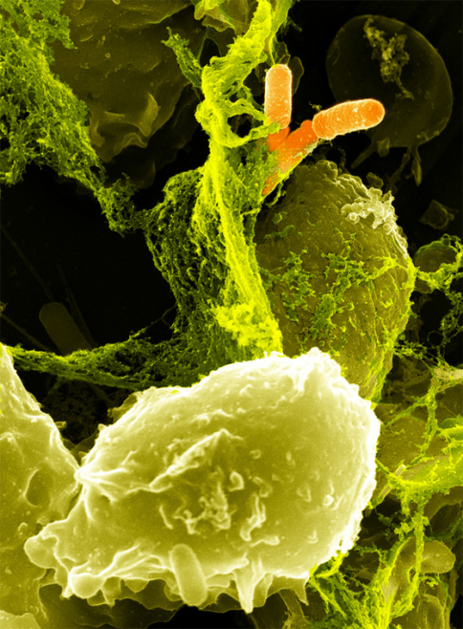
Shigella
The genus Shigella belongs to the family Enterobacteriaceae, as do the salmonellae and escherichiae. Only four species are recognized: S. dysenteriae, S. flexneri, S. boydii, and S. sonnei. S. dysenteriae is a primary pathogen that causes classic bacillary dysentery; as few as 10 CFU are known to initiate infection in susceptible individuals. By applying data from two cruise ship outbreaks to a mathematical model, it was estimated that the outbreaks could have been due to ingestion of a mean of 344 Shigella cells per meal and 10.5 to 12 cells per glass of water. Although this syndrome can be contracted from foods, it is not considered to be a food-poisoning organism in the same sense as the other three species, and it is not discussed further. Unlike the salmonellae and escherichiae, the shigellae have no known non human animal reservoirs.

Slide 7
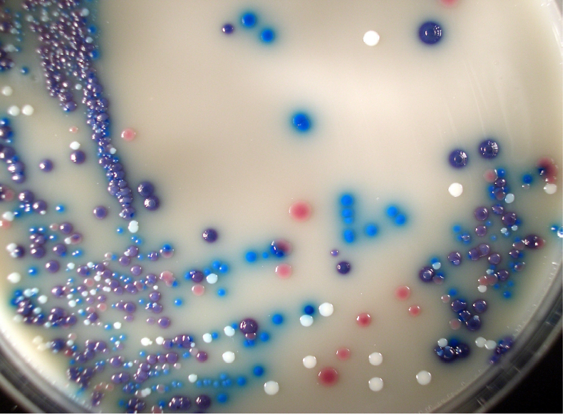
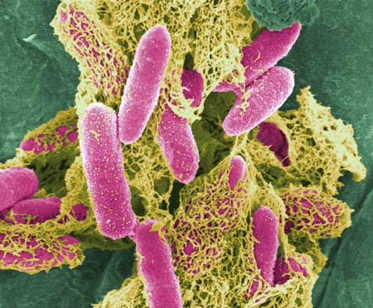
Escherichia coli
Escherichia coli, a prokaryote commonly found in gastrointestinal tracts of humans and animals, is a member of the family Enterobacteriaceae, which also includes the genera Salmonella, Shigella, Klebsiella and Enterobacter.
E. coli is a Gram-negative straight rod, facultatively anaerobic, oxidase negative and
catalase positive, and usually motile.

Slide 8
VTEC
In Europe, most commonly, the cytotoxin produced by E. coli serotype O157 has been called verotoxin (verocytotoxin) due to its lethal in vitro effects on Vero cells. Hence, a group of E. coli producing verotoxin has been called verotoxigenic E. coli (VTEC) and currently over 100 serogroups, including O157, are recognized within VTEC. However, although all VTEC produce verotoxin, they do not always have other virulence factors that enable them to cause human disease. Therefore, not all VTEC strains are, nor can be, considered pathogenic or able to cause foodborne disease, so the use of term VTEC to denote E. coli O157 causing foodborne infections is imprecise from a food safety perspective. Furthermore, VTEC includes not only O157 but also some other non-O157 serotypes causing illness.

Slide 9
VTEC O157
This usually denotes verotoxin-producing E. coli of O (somatic) serogroup O157, but with either an ‘unspecified’ or ‘undetermined’ H (flagellar) serovar. In addition, it can include
E. coli O157 determined as non-motile, so of H-- serovar. The term VTEC O157 is imprecise
from a food safety perspective as it does not indicate whether the strains produce other virulence factors (apart from verotoxin) necessary for causing food borne illness.

Slide 10
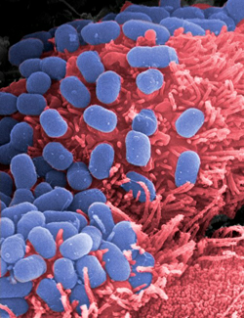
VTEC O157:H7
This denotes verotoxin-producing E. coli of the O157 serogroup and of H (flagellar) 7 serovar. The term VTEC O157:H7 is imprecise from a food safety perspective as it does not indicate whether the strains produce other virulence factors (apart from verotoxin) necessary for causing foodborne illness.

Slide 11
STEC
In United States of America, most commonly, the cytotoxin produced by E. coli O157 has been called Shiga toxin (Stx). Hence, a group of E. coli producing Shiga toxin has been called Shiga-toxigenic E. coli (STEC; including O157). However, for the same reasons as indicated for the term VTEC above, the use of term STEC to denote E. coli O157 causing foodborne infections is imprecise from a food safety perspective. Furthermore, STEC includes not only O157 but also some other non-O157 serotypes that cause illness.

Slide 12
EHEC
Those VTEC that cause enterohaemorrhagic colitis (i.e. a subset of VTEC) have been called enterohaemorrhagic E. coli (EHEC; including O157), particularly in the medical domain. In addition to possessing a particular 60 MDa plasmid coding for verotoxigenicity, EHEC posses other necessary virulence factors, such as the A/E factor causing attaching and effacing lesions on the surface of epithelial cells. However, some EHEC strains do not cause enterohaemorrhagic colitis as the only clinical manifestation of the human infection; either instead of, or in addition to, they cause other manifestations, i.e. HUS or TTP. Therefore, because it inherently relates only to one of the possible clinical manifestations (i.e. HC), the use of the term EHEC to denote E. coli O157causing foodborne infections is imprecise from a food safety perspective. Further more, EHEC includes not only O157 but also some other non-O157 serotypes causing foodborne illness.

Slide 13
HP-VTEC
More recently, the use of the term Human pathogenic verotoxigenic E. coli (HP-VTEC; including E. coli O157) has been proposed (EU, 2003) in an attempt to cover both key aspects, namely the ability to cause illness of ‘any’ clinical manifestation in humans, and the ability to produce verotoxin. However, the use of the term HP-VTEC has not yet been widely adopted, and also HP-VTEC includes not only O157 but also some other non-O157 serotypes causing foodborne illness.

Slide 14
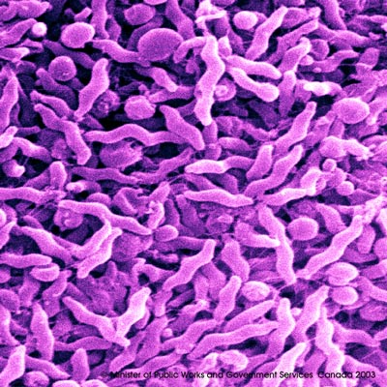
Campylobacter
The genus Campylobacter currently comprises 23 species (2009) and this number is constantly increasing due to the identification of new species. Members of the genus are typically Gram-negative, non-spore-forming, S-shaped or spiral shaped bacteria. They are microaerophilic, but some can also grow aerobically or anaerobically. Thermophilic Campylobacter (C. jejuni, C. coli, C. lari, C.upsaliensis and C. helveticus) do not grow below 30°C and have an optimal growth temperature at42°C. Campylobacter is sensitive to many external physical conditions as low water activity, heat, UV light and salt.

Slide 15
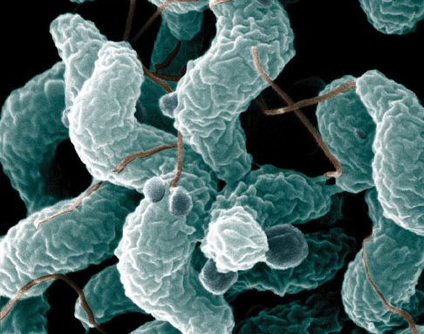
Treatment of C. jejuni Infections
Supportive measures, particularly fluid and electrolyte replacement, are the principal therapies for most patients with campylobacteriosis. Severely dehydrated patients should receive rapid volume expansion with intravenous fluids. For most other patients, oral rehydration is indicated. Although Campylobacter infections are usually self limiting, antibiotic therapy may be prudent for patients who have high fever, bloody diarrhea, or more than eight stools in 24 hours; immuno suppressed patients, patients with blood stream infections, and those whose symptoms worsen or persist for more than 1 week from the time of diagnosis. When indicated, antimicrobial therapy soon after the onset of symptoms can reduce the median duration of illness from approximately 10 days to 5 days.

Slide 16
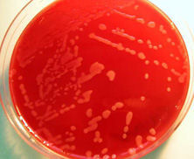
Pathogenesis
The pathogenesis of C. jejuni infection involves both host- and pathogen-specific factors. The health and age of the host and C. jejuni-specific humoral immunity from previous exposure influence clinical outcome after infection. In a volunteer study, C. jejuni infection occurred after ingestion of as few as 800 organisms. Rates of infection increased with the ingested dose. Rates of illness appeared to increase when inocula were ingested in a suspension buffered to reduce gastric acidity. Many pathogen-specific virulence determinants may contribute to the pathogenesis of C. jejuni infection, but none has a proven role.

Slide 17
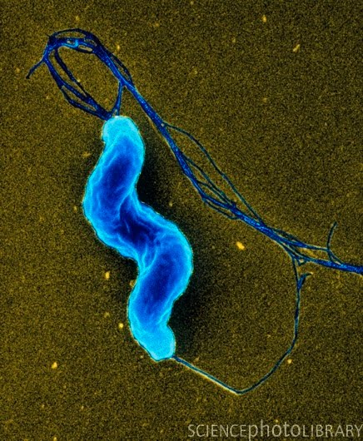
Reservoirs
The ecology of C. jejuni involves wildlife reservoirs, particularly wild birds. Species that carry C. jejuni include migratory birds, cranes, ducks, geese and seagulls. The organism is also found in other wild and domestic bird species, as well as in rodents. Insects can carry the organism on their exoskeleton. The intestines of poultry are easily colonized with C. jejuni. Day-old chicks can be colonized with as few as 35 organisms. Most chickens in commercial operations are colonized by 4 weeks.

Slide 18
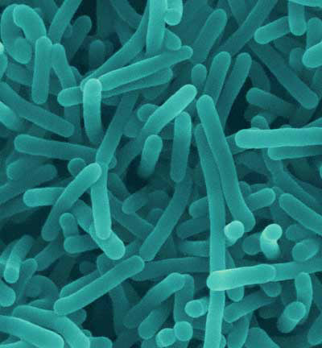
Listeria
The bacterium, Listeria monocytogenes, is a Gram-positive rod-shaped bacterium. The genus Listeria includes 6 different species (L. monocytogenes, L. ivanovii, L. innocua, L. welshimeri, L. seegligeri, and L. grayi). Only L. monocytogenes is consistently associated with human illness. There are 13 serotypes of L. monocytogenes which can cause disease, but more than 90 percent of human isolates belong to only three serotypes: 1/2a, 1/2b, and 4b. L. monocytogenes serotype 4b strain is responsible for 33 to 50% of sporadic human cases worldwide and for all major foodborne outbreaks in Europe and North America since the 1980s.

Slide 19
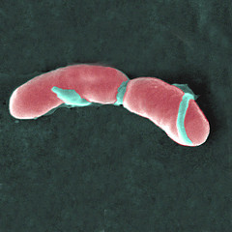
Hazard Identification
Listeria monocytogenes is a bacterial pathogen causing serious illness in humans. L. monocytogenes can cause a variety of infections, but listeriosis most often affects the pregnant uterus, the central nervous system, or the blood stream. Although listeriosis can occur in otherwise health adults and children, the most commonly affected populations include pregnant women, neonates, the elderly, and those persons who are immunosuppressed by medications or illness.

Slide 20
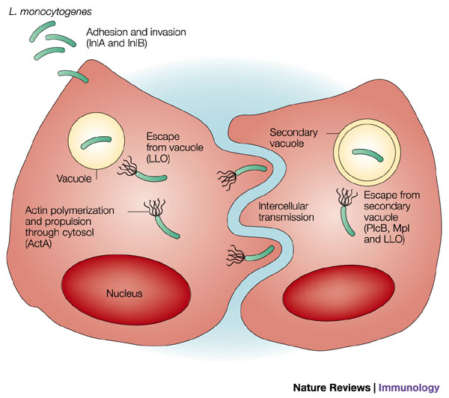
The Disease
Listeriosis, although often acquired by ingestion of contaminated food, has until recently not been recognised as causing symptoms normally attributed to the usual types of food poisoning. However, three recent documented foodborne outbreaks of listeriosis include many cases where the presence of high levels of L. monocytogenes has resulted in the rapid onset of symptoms of vomiting and diarrhoea with few apparent cases of the more classical infection. Epidemiological information related to listeriosis is to some degree dependent on the regulatory situation regarding the reporting of L. monocytogenes and listeriosis.

Slide 21
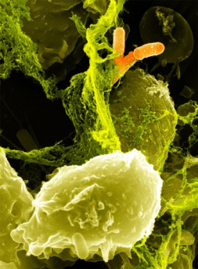
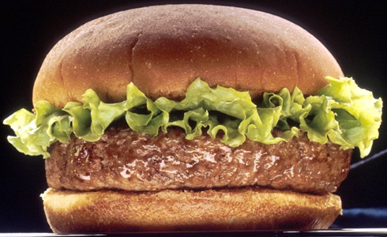
Data on growth of L. monocytogenes in food
L. monocytogenes has the ability to survive the manufacturing and ripening of many types of cheeses, surviving best in cheeses such as camembert and least in products such as cottage cheese. In general, L. monocytogenes appears to be capable of survival on meat regardless of treatments such as freezing, surface dehydration, and simulated spray-chilling, and growth is highly dependent on the temperature, pH and type of meat, as well as background microflora present. Poultry supported growth better than other meat products, whereas roast beef, summer sausage and hot dogs supported it the least, due to inhibition through pH, combined pH and water activity, and liquid smoke, respectively. L. monocytogenes can grow on fresh produce stored at refrigeration temperatures. Growth on asparagus, broccoli, and cauliflower stored at 4 °C, lettuce at 5 °C and chicory endive at 6.5°C have been reported.

Slide 22
Stapyhylococcus
Staphylococcus aureus is a non-motile facultative anaerobic Gram-positive coccus. Cells are spherical single and of ten form grape-like clusters. The organism produces catalase and coagulase. The staphylococcal cell wall is resistant to lysozyme and sensitive tolysostaphin, which specifically cleaves the pentaglycin bridges of Staphylococcus spp. The organisms are able to grow in a wide range of temperatures (7°C to 48°C with an optimum of 30°C to 37°C), pH (4.2to 9.3, with an optimum of 7.0 to 7.5); and sodium chloride concentrations (up to 15% NaCl). These characteristics enable the bacteria to survive in a wide variety of foods, especially those require manipulation during processing, including fermented food products like cheeses.

Slide 23
Thank you for your attention!

